Slide 1
Introduction to Citizen Journalism
Dr. Yue (Nancy) Dai
Department of Media and Communication
City University of Hong Kong

Slide 2
Lecture Outline
The technological foundation for citizen journalism
The history of citizen journalism and its development
The typology of citizen journalism
The strength and weakness of citizen journalism

Slide 3
Socractive Exercise
Room: DY2022
How do social media differ from other media in terms of the way in which communication activities are conducted?

Slide 4
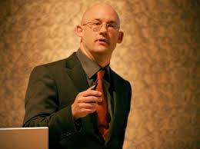
How Social Media Can Make History
Clay Shirky on
how social media
can make history

Slide 5
How Social Media Can Make History
The Internet – the 1st medium in history that can support for groups and conversation at the same time
Digitalization - the Internet also becomes the mode of carriage for all other media type
The internet becomes a site of coordination rather than just a medium for information
Decentralized information production
Makes it difficult for the government to censor information 只能在发布后审查而不是发布前
UGC (user-generated content):
produced locally
by amateurs
produced quickly
no way to filter it as it appears

Slide 6
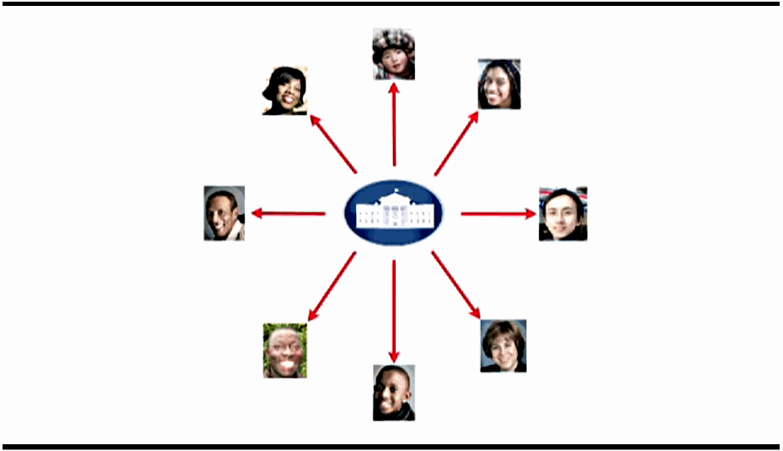
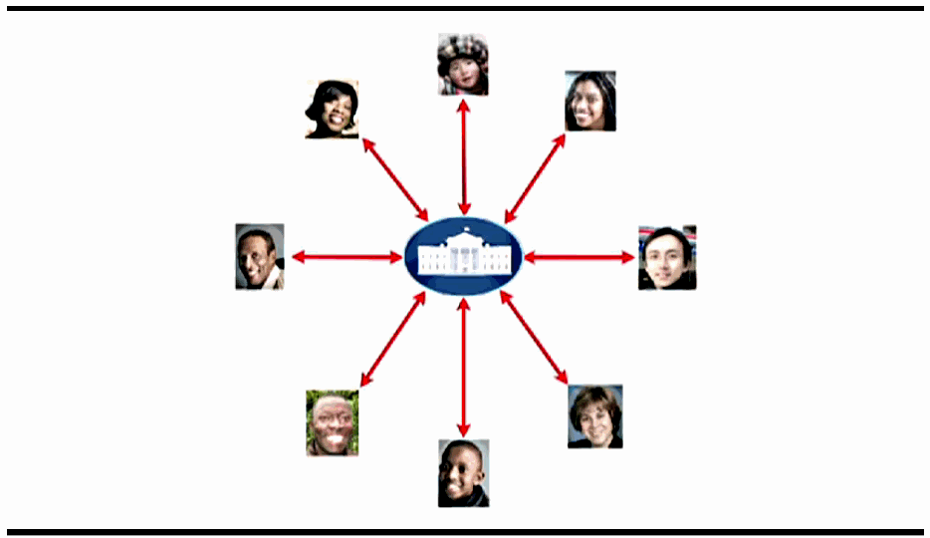
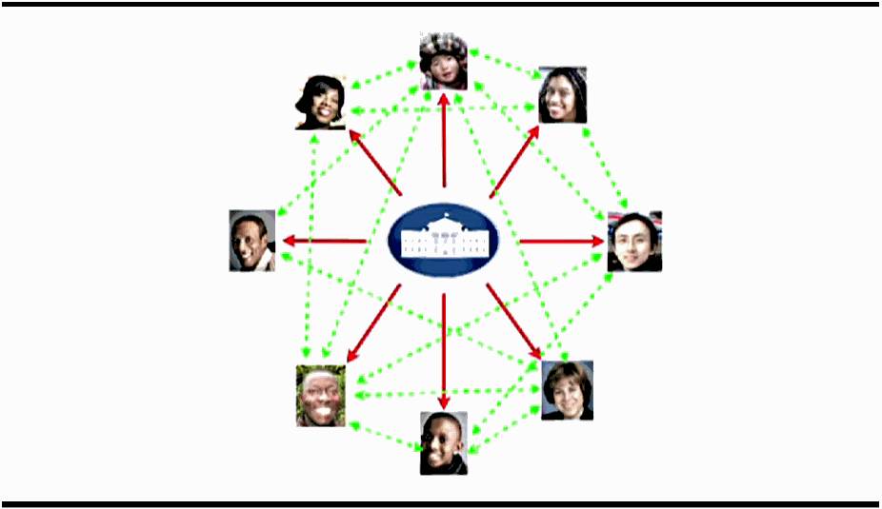
One-way → Two-way → Participatory
Web 2.0

Slide 7
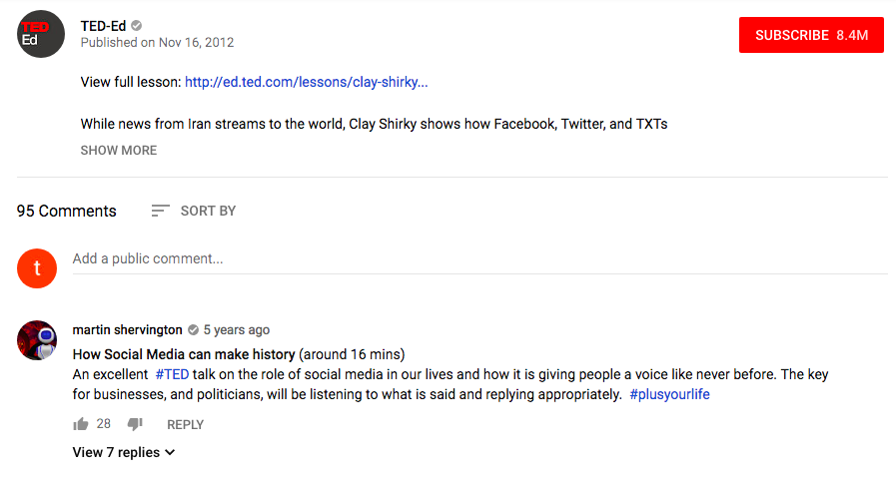

Slide 8
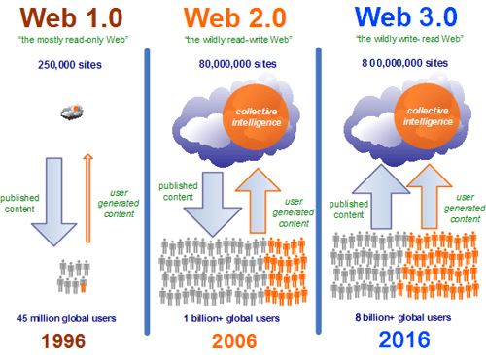
Tech-Drives for Citizen Journalism

Slide 9
Web 1.0
Started with Tim Berners-Lee’s personal database of people and software models that featured hyperlinked text
Tim Berners-Lee’s TED talk on how he invented the world wide web: https://www.youtube.com/watch?v=OM6XIICm_qo&ab_channel=TED
1989: Tim Berners-Lee wrote a proposal for “a large hypertext database with typed links”, which received support from his boss (“World Wide Web”)

Slide 10
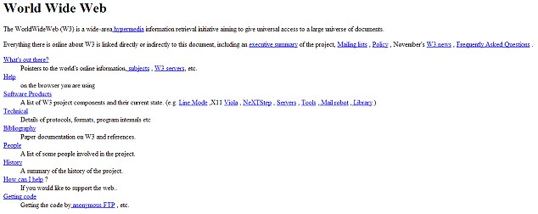
The First Webpage Built

Slide 11
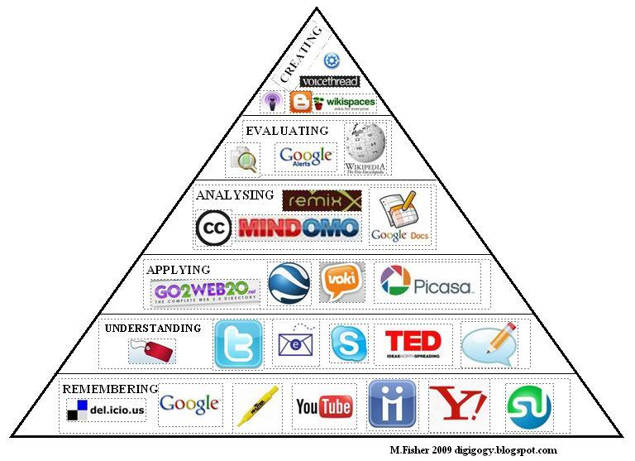
Web 2.0
Second generation of services available on the web that lets people collaborate and share information online

Slide 12


Tech-Drives for Citizen Journalism
User-generated content: write & read v.s. read-only
Quick and cheap self-service: Go to the site-> Sign up -> Use
Connectedness: social media
People easily make connections they would not otherwise have been able to make (e.g., people with common interests)
Makes the public’s opinion known and makes whom used to be the audience the producer of content

Slide 13
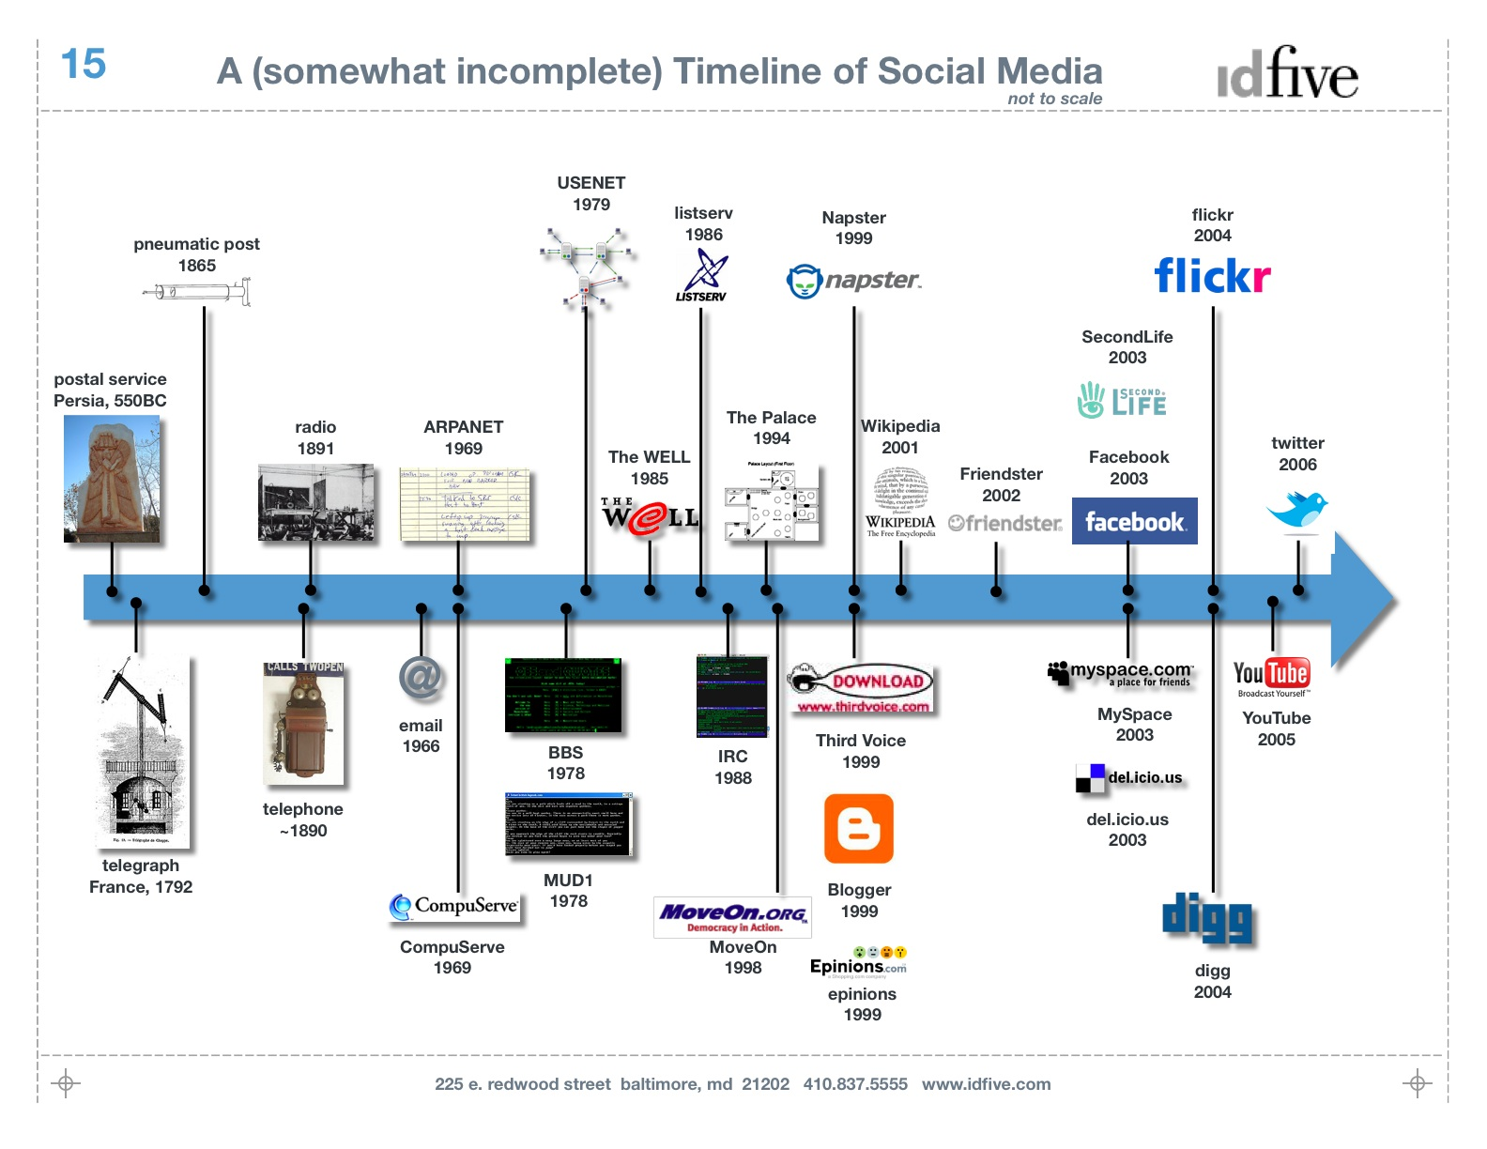

Slide 14
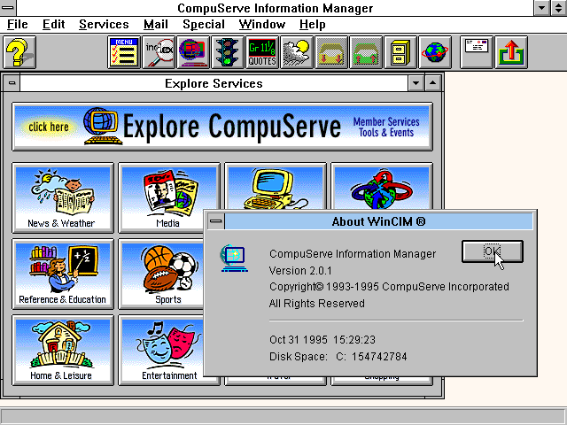

Slide 15
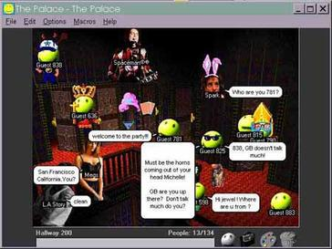
Text- and graphic-
based role
playing computer
game in the
early days

Slide 16
Web 3.0
Moving to a new communication age where user-generated content continues to increase and becomes mainstream

Slide 17
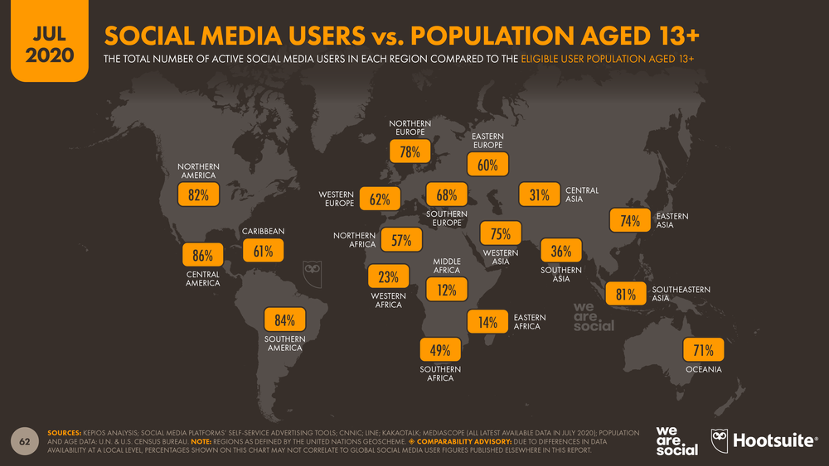

Slide 18
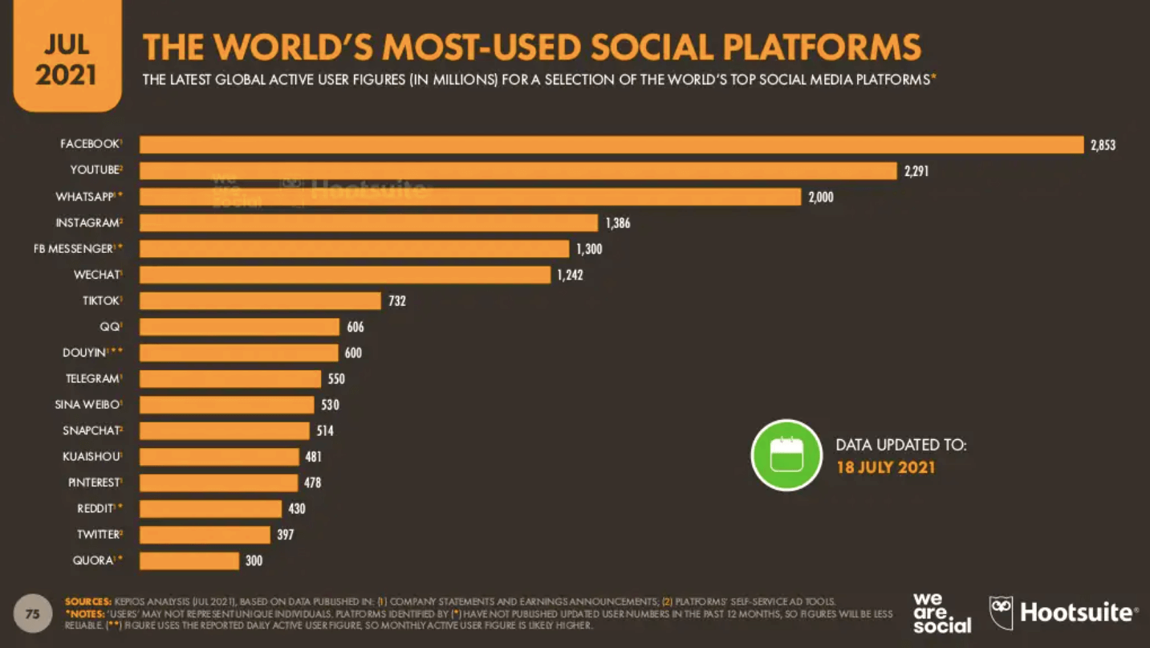

Slide 19
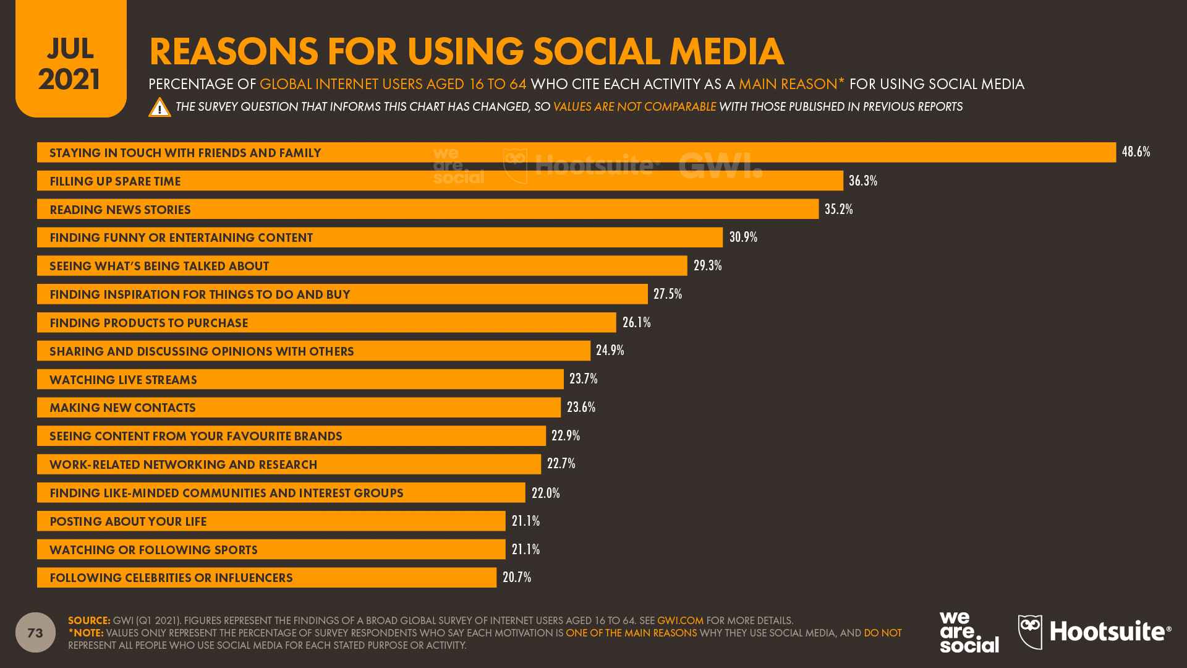

Slide 20
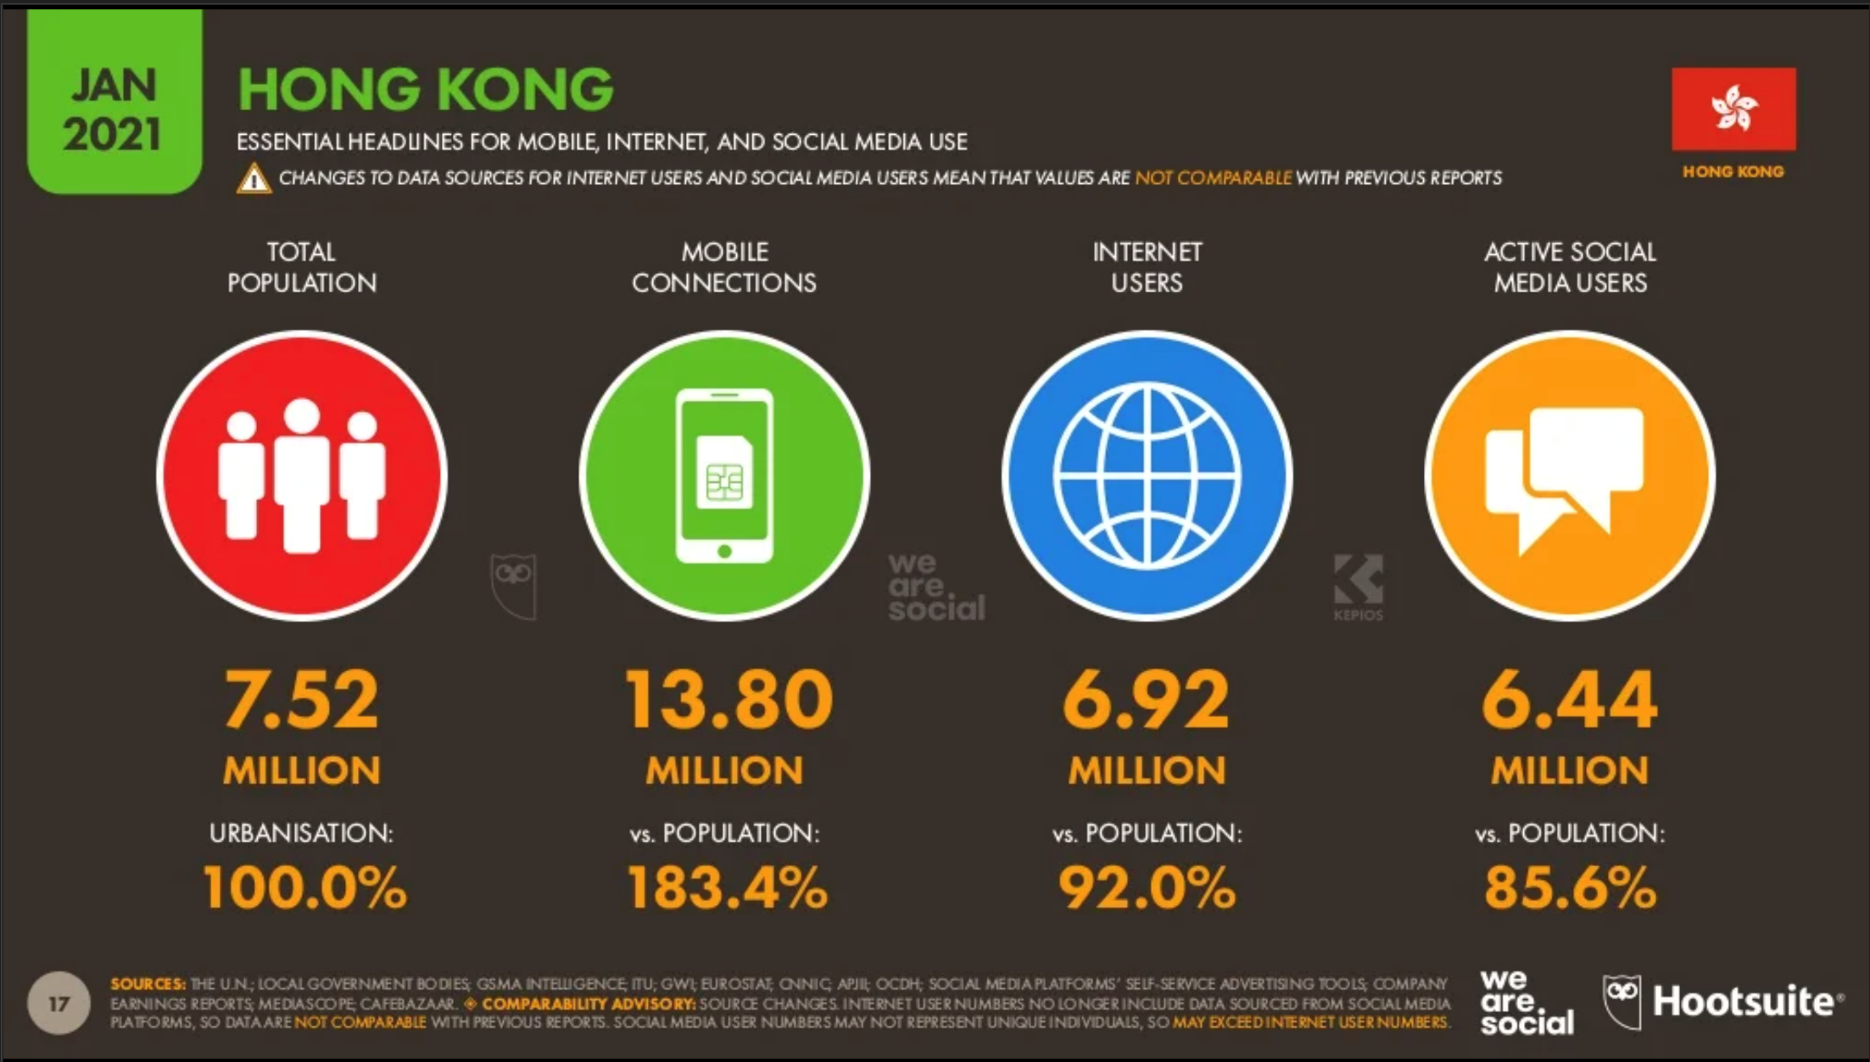

Slide 21
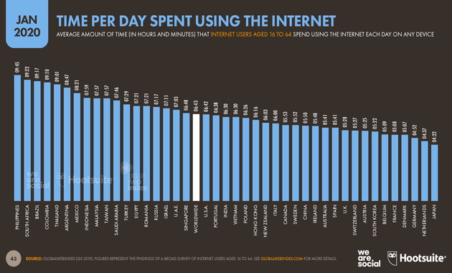

Slide 22
Citizen Media/We Media
The communication power developed by grassroots people or individuals on the Net (“自主媒體/草根媒體”)
The content is not produced by the media professionals in traditional media organizations but by regular people

Slide 23
Citizen Journalism: Definition
The public plays an active role in the process of collecting, reporting, analyzing and disseminating（傳播） news and information with the intent to provide independent, reliable, accurate, and wide-ranging information that a democracy requires.
- Bowman &Willis (2003)

Slide 24
Alternative Names for Citizen Journalism
Citizen Journalism
Grassroots
Journalism
Hyperlocal Journalism
Participatory Journalism
Open-source Journalism
Networked Journalism
Citizen media
Distributed Journalism
Stand-alone Journalism
Bottom-up Journalism
Things being highlighted:
Bottom-up
Less editorial
Independent
Distributed

Slide 25
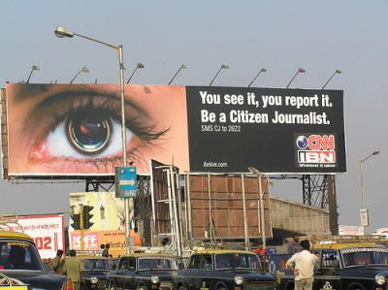
Who are citizen journalists?
Amateurs: People without professional journalism training
Anyone who cares to report
about what he/she sees
The people formerly known
as the audience (Rosen, 2006)

Slide 26

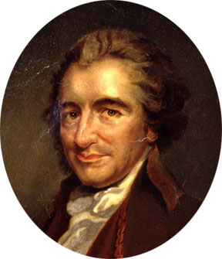
A brief History: The Earliest Citizen Journalists
Tom Paine
Wrote the famous pamphlet Common Sense

Slide 27
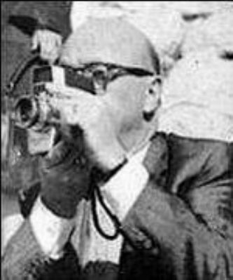
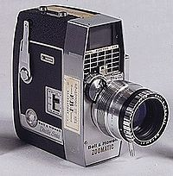
A brief History: The Earliest Citizen Journalists
Abraham Zapruder
filmed the assassination of President John Kennedy in 1963

Slide 28
A Brief History: CJ in the digital age
Early forms of citizen journalism in the digital age are mainly about covering crisis from an eye-witness’ perspective

Slide 29
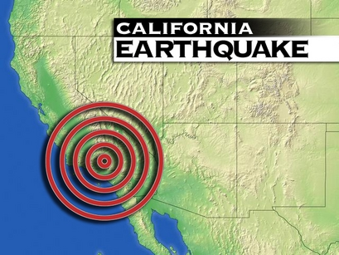
Some Landmarks in Crisis Reporting
1994
Disaster eye-witnesses report
Earthquake in Northridge, California
“New News Medium” was born
“No information structure had ever been able to do anything like that.”

Slide 30
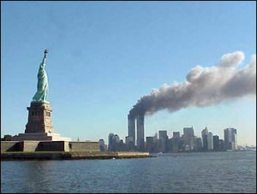

Some Landmarks in Crisis Reporting
2001: The 911 incident
A first-person news reporting network consisted of personal websites
Served as a decentralized network that couldn’t be brought down by military（軍事） attack

Slide 31
Some Landmarks in Crisis Reporting
2001: The 911 incident
Forwarded through email many times over, by people who did not know the original writer or photographer
Cathartic effect: “social history in its rawest（最原始的）, tear stained form”

Slide 32
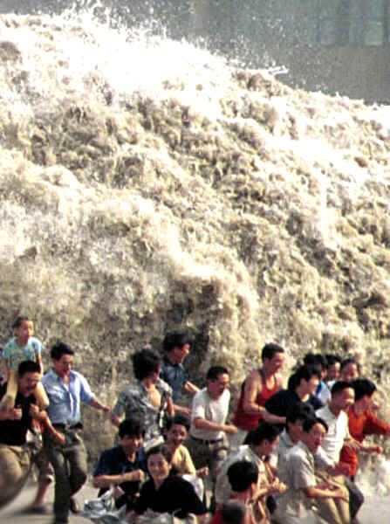
Some Landmarks in Crisis Reporting
2004: South Asian Tsunami
First-person accounts
(email stories)
Video footage（視頻資料）
Photos
Digital community
Bulletin board（公告板）
Survivors’ amateur videos
appear in mainstream news
(Sets up the foundation for the
larger notion of citizen journalism)

Slide 33
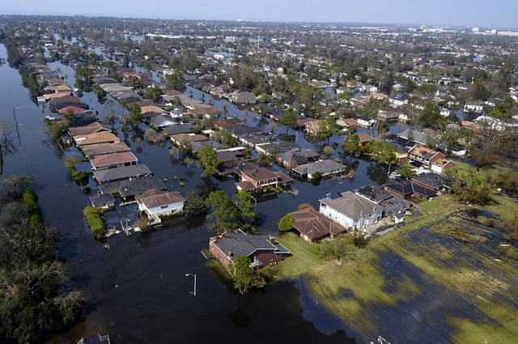
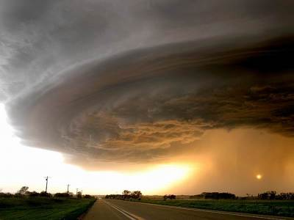
Some Landmarks in Crisis Reporting
2005: Hurricane Katrina (Florida and Louisiana)
CNN received by email more than 3,000 files with hundreds of images and video
Many blogs included links to charity groups for people wanting to make donations
“The people’s platform”

Slide 34
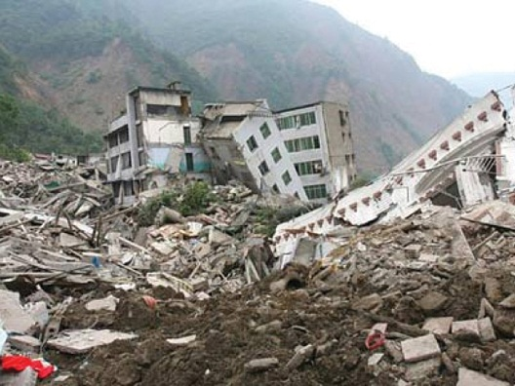
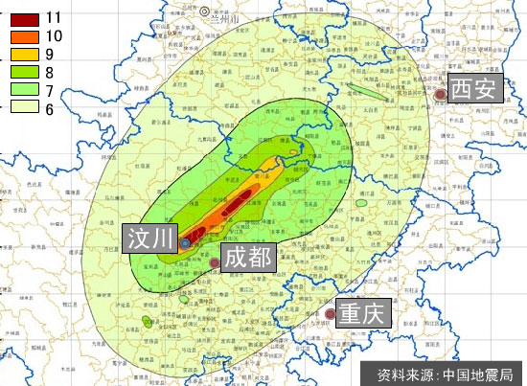
Some Landmarks in Crisis Reporting
2008: Wen Chuan Earthquake
Bulletin Board/Blog became the major way to spread and receive information
The first video: a student’s dorm video: http://youtu.be/nS0Z0zLoOSo

Slide 35
A Brief History: CJ in the digital age
Early forms of citizen journalism are mainly about covering crisis from eye-witness’ account
As it develops, citizen journalism got more diversified（多元化） and the stories were produced from multiple perspectives

Slide 36
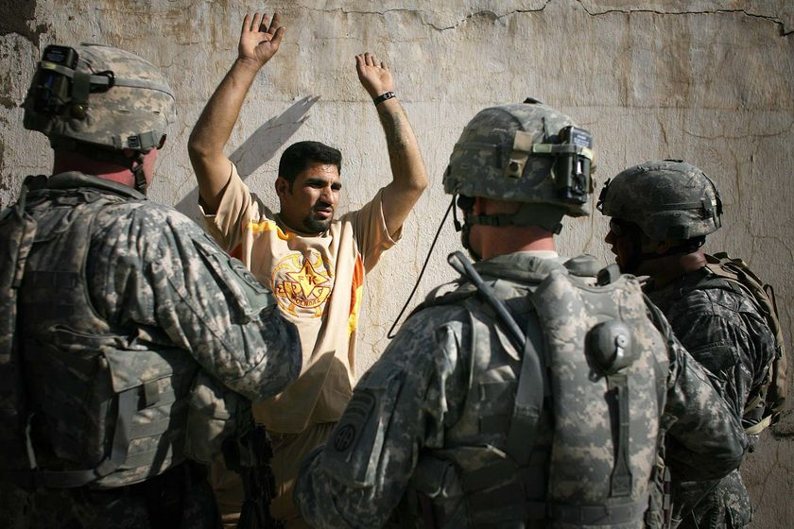
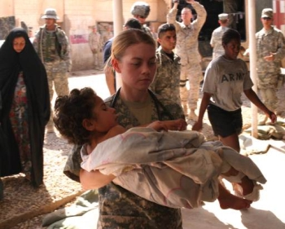
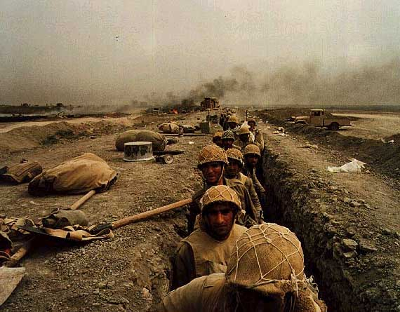
From the Insiders
2004: Iraq War
Warblogs & Microblogs written by soldiers
Encountered censorship issue

Slide 37
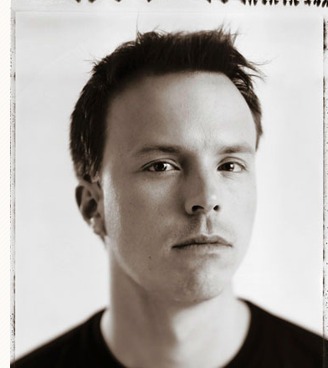
justanothersoldier.com
Jason Christopher Hartley
Retired member of the New
York Army National Guard
Served in Iraq in 2004
Author of Just Another Soldier

Slide 38
A Brief History: CJ in the digital age
Early forms of citizen journalism are mainly about covering crisis from eye-witness’ account
As it develops, citizen journalism got more diversified and the stories were produced from multiple perspectives
Citizen journalism plays a critical role in social movements

Slide 39
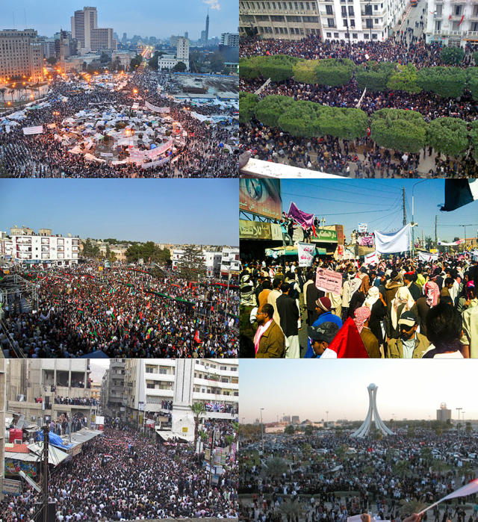
Arab Spring (2010-2012)

Slide 40

Occupy
WALL STREET
(2011)
-160,000 fb LIKES
-Youtube videos
-www.occupywallst.org
#occupywallst

Slide 41
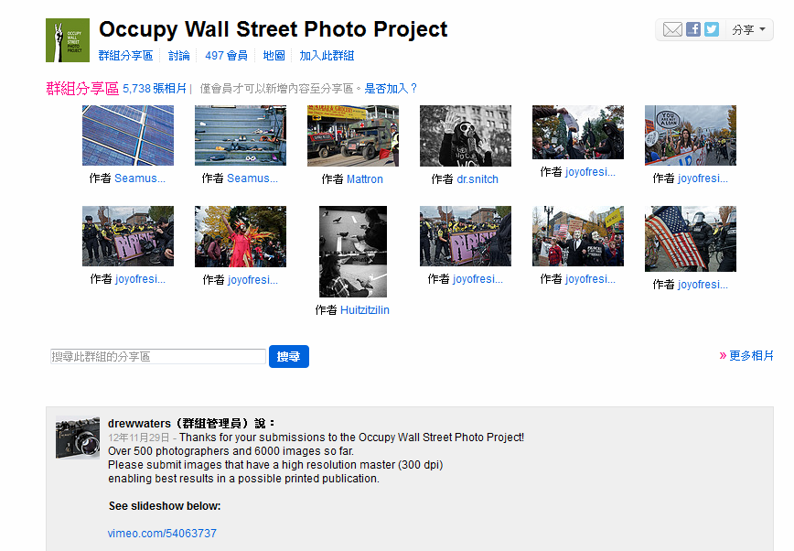

Slide 42
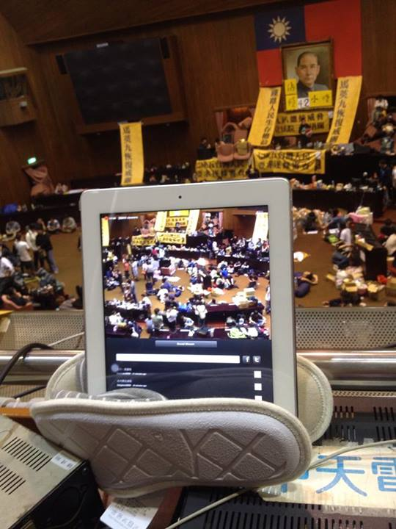
Sunflower Student Movement in Taiwan
(2014)

Slide 43
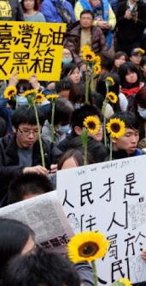
Sunflower Student Movement in Taiwan (2014)
The Sunflower Student Movement is associated with a protest movement driven by a coalition of students and civic groups with the purpose of demanding clause by clause review of a trade pack Taiwan signed with mainland China, which they perceive would hurt Taiwan's economy and leave it vulnerable to political pressure from Beijing.
“The communication mediated by Facebook.com and PTT.CC formed a network with rather high degree of centralization, upon which an information cascade emerged among young college students in the very beginning of Sunflower Movement”

Slide 44

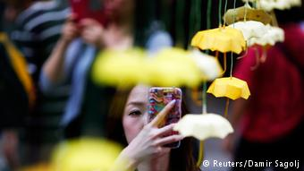
2014 Umbrella Revolution
The protests began after the Standing Committee of the National People‘s Congress (NPCSC) issued a decision regarding proposed reforms to the Hong Kong electoral system, which is largely seen as highly restrictive.

Slide 45
2019-2020 hong Kong protests
Triggered by the introduction of the Fugitive Offenders amendment bill (Extradition Bill) by the Hong Kong government.
Later escalated into a series of deeper conflicts between citizens, the police, and the government.
Exacerbated the rift among the citizens based on political orientations.

Slide 46
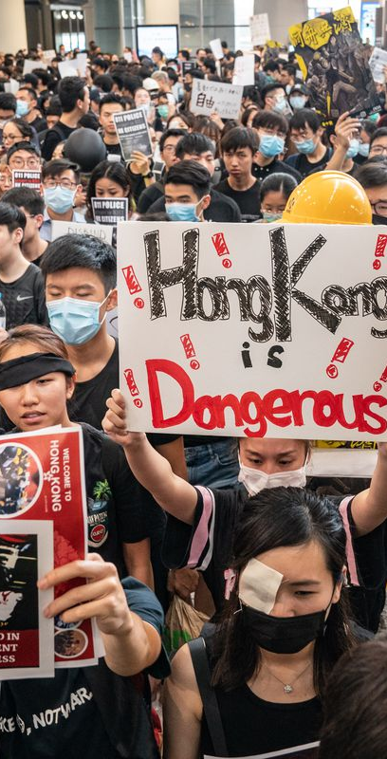
2019-2020 hong Kong protests
Role of social media and citizen journalism:
Social protests organized through social media platforms (e.g., telegram, Facebook groups)
Citizen journalists documented the collisions between the protestors and the police while being a part of the demonstration themselves
Reflection question: How do you document news neutrally while you are a part of the news?
Sensational personal stories quickly spread on the Internet and fueled local and international support to the movement, and, unfortunately, in some cases, violence.

Slide 47
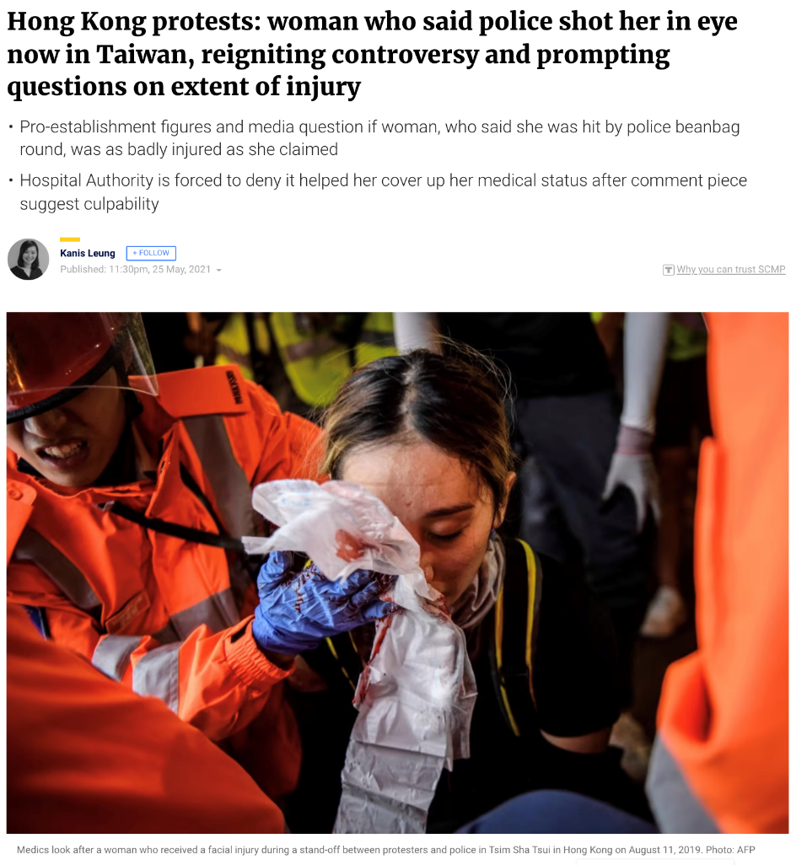
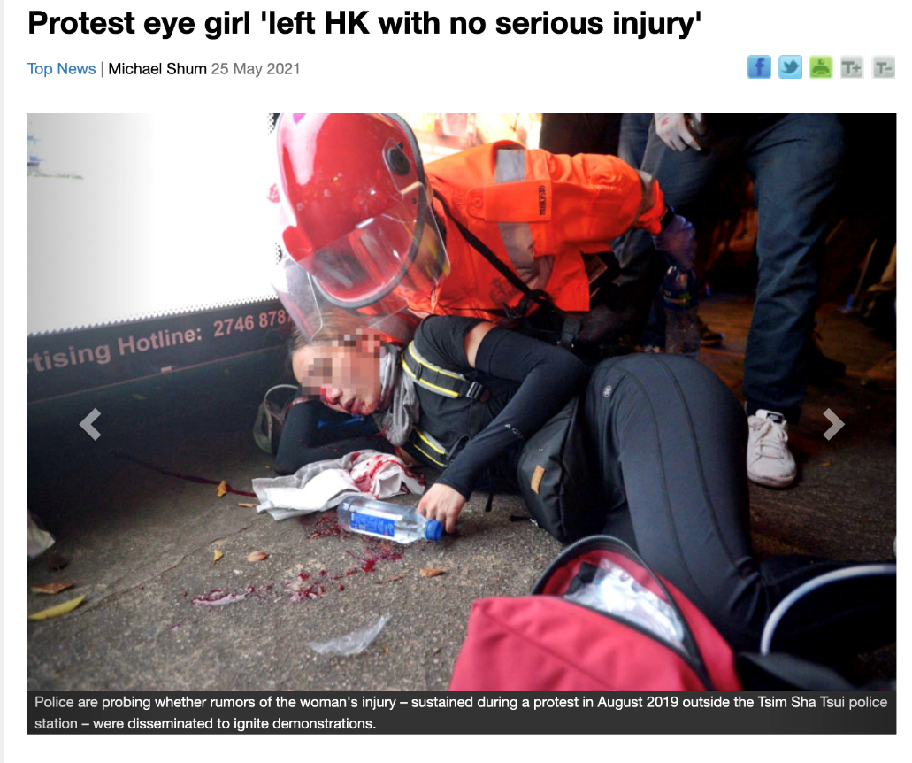
The Standard
SCMP
No conclusion on whether her injury was associated with the HK police or whether it
was intentional.

Slide 48

Does more information mean more truth?
Socrative room code: DY2022
Please write your EID before answering the question.

Slide 49
Confirmation bias
Confirmation bias is the tendency to search for, interpret, favor, and recall information in a way that confirms or supports one's prior beliefs or values.
Unconsciously select information that supports one’s own view
Ignore contradictory information to one’s existing view
Interpret ambiguous evidence as supporting one’s existing position
確認偏差是一種以確認或支持一個人先前的信念或價值觀的方式搜索、解釋、偏愛和回憶信息的傾向。
不自覺地選擇支持自己觀點的信息
忽略與現有觀點相矛盾的信息
將模棱兩可的證據解釋為支持一個人的現有立場

Slide 50
Confirmation bias
“There is no evidence that links vaccine to autism among children.”
How would you interpret this sentence?

Slide 51
Types of Citizen Journalism
(1) Use eyewitness accounts
(2) Integrate user participation into news coverage
將用戶參與整合到新聞報導中
(3) News broken on the Internet
(4) Engage public to collectively develop journalistic reports
讓公眾共同編寫新聞報導
- Richard Sambrook (2008)
Published on mainstream media platforms
Published on civic media platforms
These two are considered as the main formats of CJ

Slide 52
(1) Use Eyewitness Accounts
Mainstream media use user-generated narratives, pictures and videos in storytelling
Not a new form
Quantity is the only thing that technology has changed

Slide 53
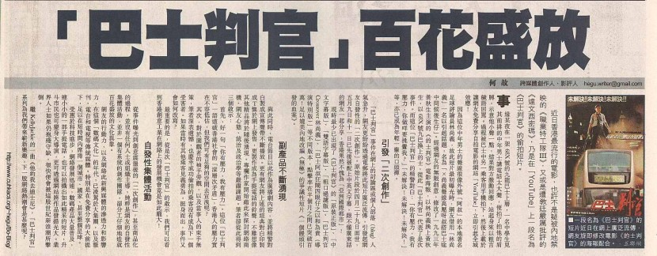
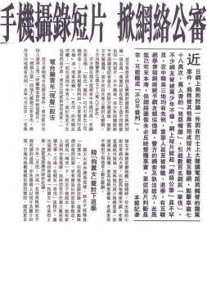

Slide 54
(2) Integrate user participation
Audience participation
Call-in format
Integrating public opinion (blogs/BBS) in news report

Slide 55
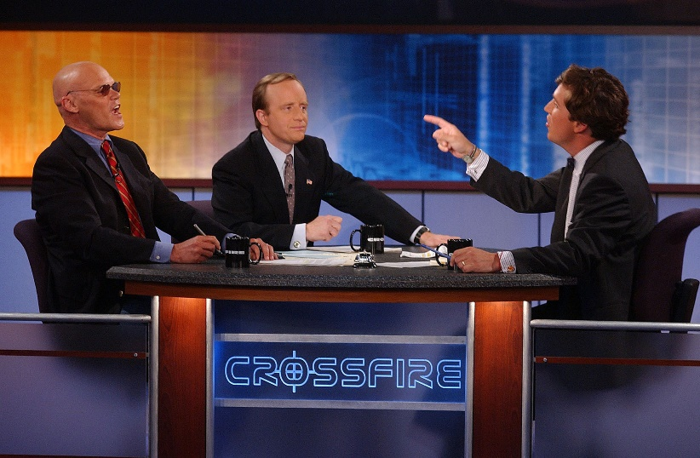


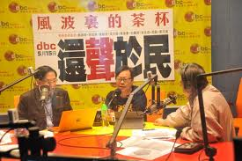
Current affairs programs
CNN current affairs programs that featured
a live studio audience
Teacup in a Storm (風波裡的茶杯) was a popular radio show in D100

Slide 56
(3) News broken on the web
Independent news and information websites (e.g., blogs/forums)
Seek to produce and disseminate brand-new stories/investigation
It may have an editorial component (fact checking and verification)
尋求製作和傳播全新的故事/調查
它可能有一個編輯部分（事實檢查和驗證）

Slide 57
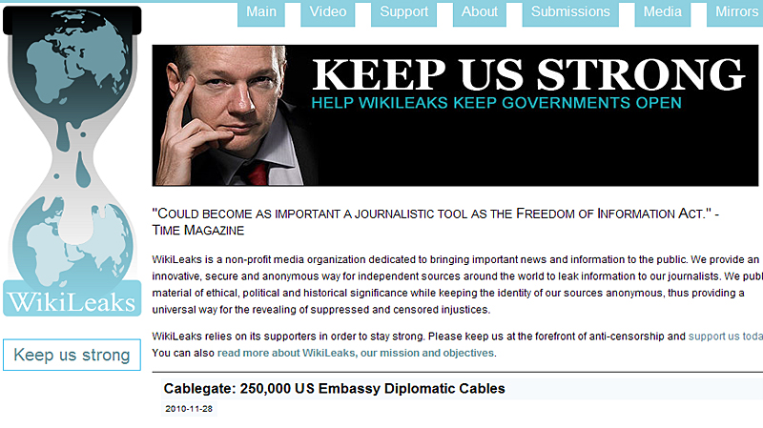

Slide 58
(4) Engage public to collectively develop journalism
Full-fledged participatory（全面參與） and collaborative news sites invite the participants to produce and disseminate news
"Open Source" reporting
Transparent operation
Collective wisdom

Slide 59
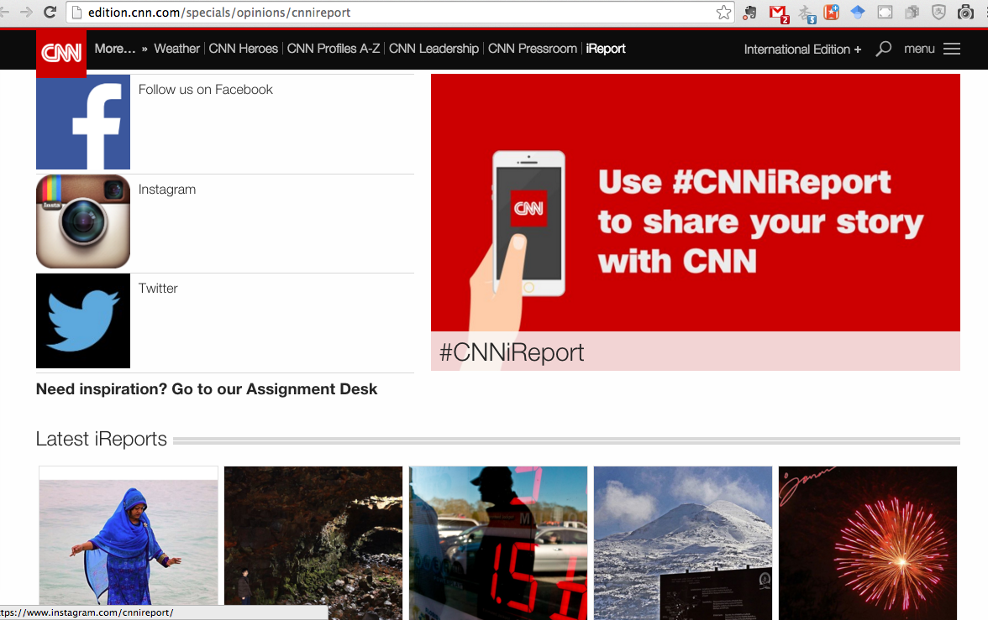
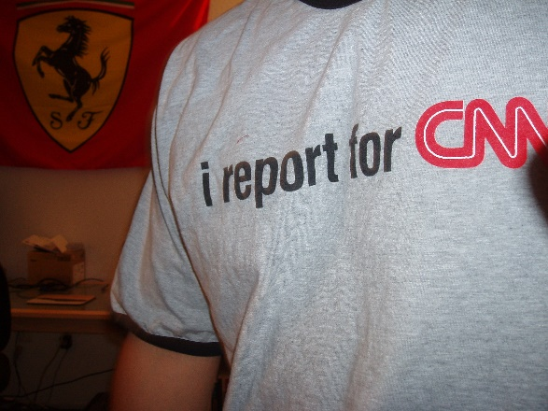

Slide 60

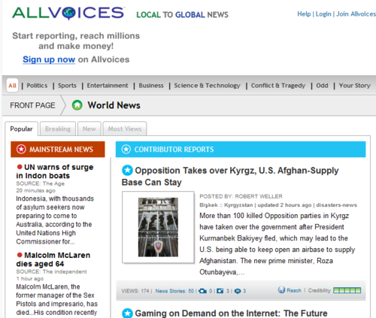

United States: GroundReport, Allvoices, Demotix
Used a Wikipedia-like model of volunteer editors and community feedback, combined with a star rating system.

Slide 61
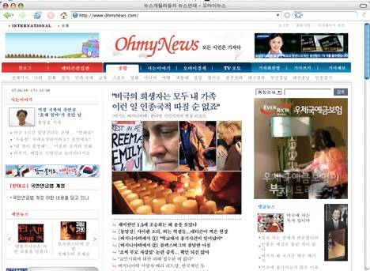
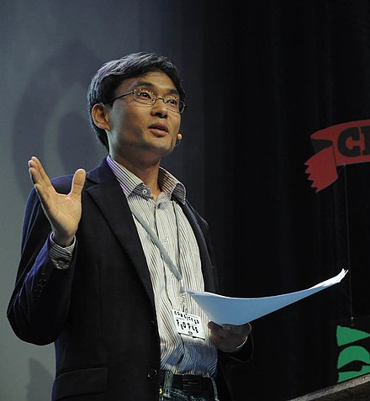
South Korea: OhMyNews
Founder: Oh Yeon-ho

Slide 62
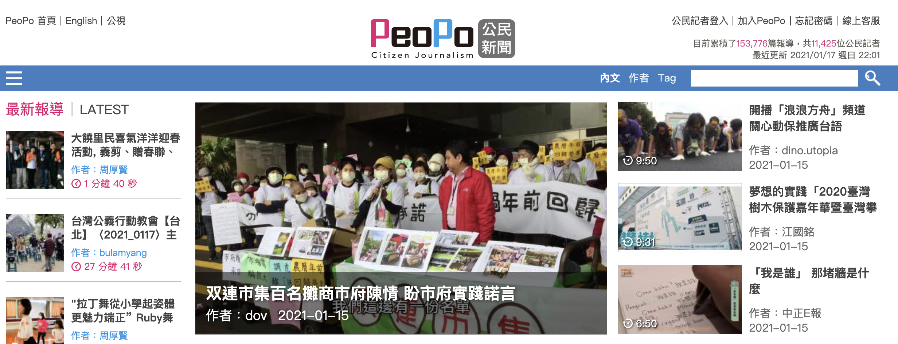
Taiwan: Peopo News

Slide 63
Types of Citizen Journalism
(1) Use eyewitness accounts
(2) Integrate user participation into news coverage
(3) News broken on the web
(4) Engage the public to collectively develop journalism
-- These activities are integrating to become part of the “routine reflex” of the news industry.

Slide 64
Characteristics of Citizen Journalism
Approach:
Non-mainstream view point
Anti-hegemony（反霸權主義）
News Content:
More social, political, and cultural issues
Reflects the interests of minorities and marginalized groups（邊緣化群體）
Reporting style:
Advocacy, promote social movement
Subjective perspective
Interactive

Slide 65
Strength of Citizen Journalism
Equal access to the power of communication
Low cost (cheap labor)
Cover more events
Multiple perspectives
Creativity in reporting

Slide 66
Returning to an earlier Question…
Does more information mean more truth?
Agenda setting theory: News media have the power of influencing the importance placed on the topics of the public agenda
The media may not be good at telling you what to think but it’s good at telling you what to think about.
The emergence of citizen journalism makes it such that mainstream news outlet no longer sets the public’s agenda in terms of what is important to the society
But! Personalized/customized news subscriptions do…
Broadcasting → Narrowcasting

Slide 67
Weakness of Citizen Journalism
Subjective, trivial
People can become paparazzi（狗仔） (privacy issue)
No gate-keeping
lack of training in news values
Lack of training on news reporting quality (objectivity, neutrality, fair and balance, etc.)
Rumor（謠言）, credibility problem (lack of accountability（問責製）)

Slide 68

Fake News

Slide 69

Fake News
Fake news: News articles that intentionally and verifiably false.
It overlaps（重疊） with misinformation (false or misleading information) and disinformation (purposefully spread false information)
Commonly spread over clickbait and bot
Clickbait（點擊誘餌）: A headline or
the leading words of a
social media post written
to attract attention by
offering odd,
amazing, or suspenseful
phrases that induce curiosity

Slide 70
How to spot fake news
Most easily used criteria: Source and Intention
Fact checkers
Various database resources can help visualize the path of the
spread of information online
E.g., TwitterTrails, RumorLense, Hoaxy, PolitiFact, Snopes.com
Games that teach about fake news
Factitious, Bad News, Fake It to Make it
Notes:
Factitious is a game intended to help players learn how to identify fake news stories. The game shows actual news articles, without revealing their publication source until the player clicks to see it. It asks players to identify if the article is real or fake. After it tells you whether you were right or wrong, the game highlights elements of the news article that can be used to help identify if the article is real or fake.
Bad News puts players in the role of producers of misinformation and fake news in return for badges rewarded to the “masters of disinformation.” Players learn to distort the truth, plant falsehoods, and deflect attention among their virtual Twitter followers. By exposing people to fake news production processes and helping them gain hands-on experience, Bad News is able to help people develop increased familiarity to fake news distribution practices and immunity towards manipulation.
Fake It to Make It also puts the player in the role of the creator of fake news, trying to make money from advertisers by setting up a site, copying news stories and re-posting them, creating fake social media accounts and generating interest by choosing users and groups to target with social media messages. It provides a running tally of how much attention your website has gotten and how much money you’ve made. You quickly get a sense of what questionably-ethical strategies work best – it’s amazing how low you can sink, how quickly, to start winning!

Slide 71


Slide 72
Next Time
Read Jönsson & Örnebring (2010)
Deadline for first tweet: Jan 23, 11:55pm
Hashtag: #CJ1st
You can post about any social issues/even that you think is newsworthy
Does NOT have to be local issues

Slide 73
Tips on Weekly Tweet
Must be an ORIGINAL news you collect
Texts, photos and videos included in the tweet have to be produced by you
Your personal opinions on social issues are considered original but you need to clearly identify them (e.g., “I think…”, “In my opinion...”)
Consider it as a news story, not just a tweet about your opinions on something
Check: Can your audiences easily understand your story?

